Slide 1
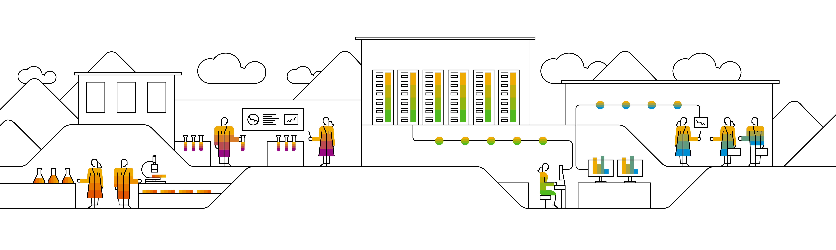
Data Analysis Report for Fond Rouge
NATWAR UPADHYAY, SAP
SEPTEMBER 05, 2022

Slide 2
Agenda
Global picture
Which locations are the biggest Revenue contributors?
Where do we see the highest number of order returns?
Where the Refunds:Revenue ratio is at the highest (worst)?
What are the locations with the worst Sentiment score?
US Problems
Using Sentiment + Refund:Revenue ratio to spot the problems
Potential Quality Issue In San Diego, CA
Possible counterfeit issues in Los Angeles & Las Vegas
Conclusion
Suggested Next Steps
Contacts

Slide 3
Global Picture

Slide 4
Which locations are the biggest Revenue contributors?

Slide 5
Where do we see the highest number of order returns?

Slide 6
Where the Refunds:Revenue ratio is at the highest (worst)?

Slide 7
Where the Refunds:Revenue ratio is at the highest (worst)?

Slide 8
What are the locations with the worst Sentiment score?

Slide 9
US Problems

Slide 10
Using Avg Sentiment + Refund:Revenue ratio to spot the problems

Slide 11
Potential Quality Issue In San Diego, CA

Slide 12
Possible counterfeit issues in Los Angeles & Las Vegas

Slide 13
Conclusion

Slide 14
Suggested Next Steps
Drill-down to discover specific affected product lines
Investigate a potential quality issue in San Diego
Contact affected customers and interview (offer prize)
Test the full order cycle with secret customers
Investigate potential counterfeit product(s) in LA & LV
Take a closer look at the bad reviews you get
Look for origin data
Perform a competition research
Ensure fantom customers don’t have the ability to leave bad reviews without actual verifiable purchases
Upgrade your trial SAP SAC account
Schedule an SAC task to continuously update the data for your models and stories from newer versions of your spreadsheets
If you want to move away from the spreadsheets
Check out some of our database solutions
They all integrate well with SAP SAC
You will see changes faster, even in real-time

Slide 15

Thank you.
Contact information:
NATWAR UPADHYAY
9836035788

